Slide 1

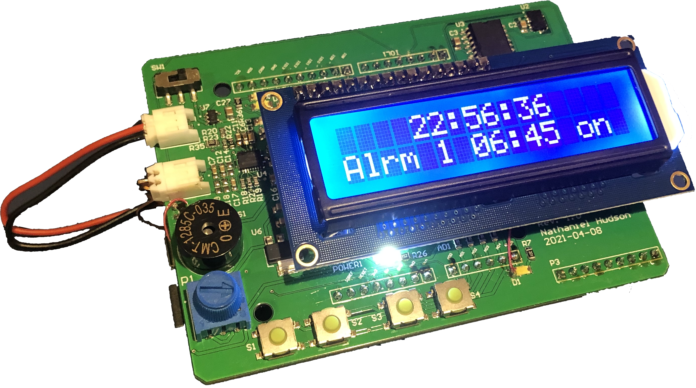
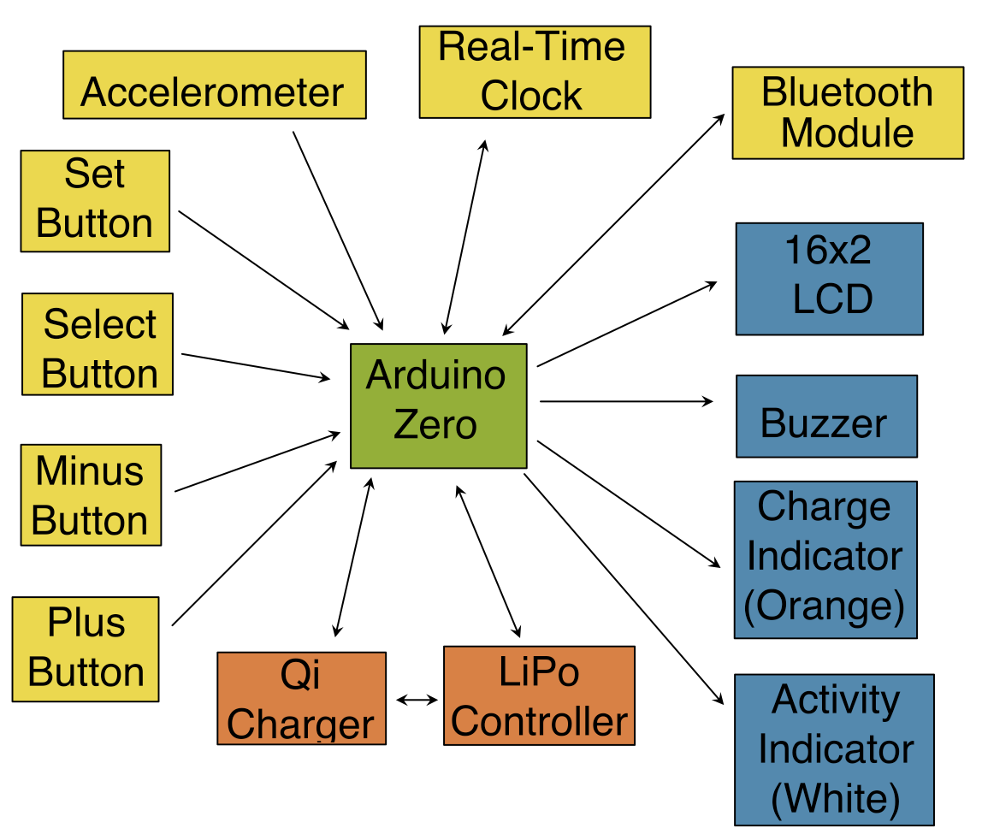

ENGE 420
Embedded Systems
Getup! Designer: Nathaniel Hudson
Project Description
Getup! is an alarm clock that requires the user to get out of bed in order to disable it. While it may appear to be a simple alarm clock, it has no buttons with which the user can snooze or disable it. Instead, it uses an accelerometer to sense when the user picks it up and stop ringing for a short time (somewhere on the order of 30 to 60 seconds). However, in order to be fully disabled, it must be placed on a wireless charging pad. Otherwise, it will continue ringing after the pause time elapses until it receives power.
User Interface
Describe your user interface:
All user interaction takes place through four buttons (set, select, up, and down), and an accelerometer. Information is displayed on a 16x2 LCD and various LEDs, and a magnetic buzzer is used for alarm sounds.
Functions:
// Determines whether specified alarm is active.
bool check_alarm(uint8_t alarm);
// Enables specified alarm.
bool enable_alarm(uint8_t alarm);
// Disables specified alarm.
bool disable_alarm(uint8_t alarm);
// Retrieves time of specified alarm.
uint16_t get_alarm(uint8_t alarm_idx);
// Edits specified alarm.
bool edit_alarm(uint8_t alarm_idx, uint16_t new_time);
Project Status
Beyond communications and power, the system functions without issue. Bluetooth communication has not been fully implemented, but the core functionality of the device is present and fully functional.

